Slide 1

SQL
Session 4

Slide 2
Introduction
DDL - Data Definition Language
DML - Data Manipulation Language
SQL Statements
DCL - Data Control Language
TCL - Transaction Control Language
Notes:
Let’s make a quick recap
SQL statements are grouped into four main categories:
DDL - Data Definition Language
DML - Data Manipulation Language
DCL - Data Control Language
TCL - Transaction Control Language
DDL, DML, DCL, TCL are not separate languages. They compose parts of a single database language which is SQL. Now, let’s look at their definitions.

Slide 3
DDL Commands

Slide 4
Table of Contents
Introduction
Data Types
CREATE TABLE
ALTER TABLE
DROP TABLE

Slide 5
Data Definition Language
DDL specifies the database schema.
Some statements used in DDL are CREATE, ALTER, DROP.
DDL statements are typically used to set up and configure a new database before we insert data.
Notes:
DDL or Data Definition Language actually consists of the SQL commands that can be used to define the database schema. It simply deals with descriptions of the database schema and is used to create and modify the structure of database objects in the database.

Slide 6
Data Manipulation Language
Data Manipulation Language (DML) enables users to access or manipulate data.
INSERT, UPDATE, DELETE, SELECT* are the statements used in DML.
* In some sources, SELECT statement is grouped into a different category called DQL (Data Query Language).
Notes:
The SQL commands that deals with the manipulation of data present in the database belong to DML or Data Manipulation Language and this includes most of the SQL statements.
INSERT – is used to insert data into a table.
UPDATE – is used to update existing data within a table.
DELETE – is used to delete records from a database table.

Slide 7
Data Control Language
Data Control Language (DCL) is used to grant or revoke access control.
Its statements are REVOKE and GRANT.
Notes:
DCL includes commands such as GRANT and REVOKE which mainly deals with the rights, permissions and other controls of the database system.
Examples of DCL commands:
GRANT-gives user’s access privileges to database.
REVOKE-withdraw user’s access privileges given by using the GRANT command.

Slide 8
Transaction Control Language
Transaction Control Language (TCL) controls the transactions of DML and DDL commands.
Some statements in TCL are COMMIT, ROLLBACK, SAVEPOINT.
Notes:
TCL commands deals with the transaction within the database.
Examples of TCL commands:
COMMIT– commits a Transaction.
ROLLBACK– rollbacks a transaction in case of any error occurs.
SAVEPOINT–sets a savepoint within a transaction.
SET TRANSACTION–specify characteristics for the transaction.
We will not cover most of the statements we have talked now.
In this lesson, we'll learn DDL commands. As a side note, we are not going to cover other languages' commands in our course.
Before we dive into the DDL commands, we'll start with data types.

Slide 9
Data Types
2

Slide 10
Data Types
The data type of a column defines what value the column can hold: integer, character, date and time, binary, and so on.
Notes:
An SQL developer must decide what type of data that will be stored inside each column when creating a table. The data type is a guideline for SQL to understand what type of data is expected inside of each column, and it also identifies how SQL will interact with the stored data.

Slide 11
Data Types
String
Date and Time
Numeric
Notes:
There are three main data types: string, numeric, and date and time.
We are not going to cover all the details of data types.
https://www.w3resource.com/sqlite/sqlite-data-types.php

Slide 12
String Data Types
The string data types are:
CHAR
VARCHAR
BINARY
VARBINARY
BLOB
TEXT
ENUM
SET
Notes:
CHAR(size):
A FIXED length string (can contain letters, numbers, and special characters). The size parameter specifies the column length in characters - can be from 0 to 255. Default is 1
VARCHAR(size):
A VARIABLE length string (can contain letters, numbers, and special characters). The size parameter specifies the maximum column length in characters - can be from 0 to 65535
BINARY(size):
Equal to CHAR(), but stores binary byte strings. The size parameter specifies the column length in bytes. Default is 1

Slide 13
Date and Time Data Types
The date and time data types are:
DATE
DATETIME
TIMESTAMP
YEAR
Notes:
DATE
A date. Format: YYYY-MM-DD. The supported range is from '1000-01-01' to '9999-12-31'
DATETIME(fsp)
A date and time combination. Format: YYYY-MM-DD hh:mm:ss. The supported range is from '1000-01-01 00:00:00' to '9999-12-31 23:59:59'. Adding DEFAULT and ON UPDATE in the column definition to get automatic initialization and updating to the current date and time
TIMESTAMP(fsp)
A timestamp. TIMESTAMP values are stored as the number of seconds since the Unix epoch ('1970-01-01 00:00:00' UTC). Format: YYYY-MM-DD hh:mm:ss. The supported range is from '1970-01-01 00:00:01' UTC to '2038-01-09 03:14:07' UTC. Automatic initialization and updating to the current date and time can be specified using DEFAULT CURRENT_TIMESTAMP and ON UPDATE CURRENT_TIMESTAMP in the column definition

Slide 14
Numeric Data Types
Integer Types (Exact Value)
INTEGER or INT
SMALLINT
TINYINT
MEDIUMINT
BIGINT
Fixed-Point Types (Exact Value)
DECIMAL
NUMERIC
Floating-Point Types (Approximate Value)
FLOAT
DOUBLE
Notes:
INT
A medium integer. Signed range is from -2147483648 to 2147483647. Unsigned range is from 0 to 4294967295. The size parameter specifies the maximum display width (which is 255)
FLOAT(size, d)
A floating point number. The total number of digits is specified in size. The number of digits after the decimal point is specified in the d parameter. This syntax is deprecated in MySQL 8.0.17, and it will be removed in future MySQL versions
FLOAT(p)
A floating point number. MySQL uses the p value to determine whether to use FLOAT or DOUBLE for the resulting data type. If p is from 0 to 24, the data type becomes FLOAT(). If p is from 25 to 53, the data type becomes DOUBLE()
DECIMAL(size, d)
An exact fixed-point number. The total number of digits is specified in size. The number of digits after the decimal point is specified in the d parameter. The maximum number for size is 65. The maximum number for d is 30. The default value for size is 10. The default value for d is 0.

Slide 15

Data Types
Data types might have different names in different database. And even if the name is the same, the size and other details may be different! Always check the documentation!
TIP
Notes:
Let’s go on with the first DDL command which is CREATE TABLE.

Slide 16
Data Definition Language
CREATE
ALTER
DROP
Notes:
DDL or Data Definition Language actually consists of the SQL commands that can be used to define the database schema. It simply deals with descriptions of the database schema and is used to create and modify the structure of database objects in the database.

Slide 17
CREATE TABLE
3

Slide 18
CREATE TABLE
When creating a table, we use CREATE TABLE statement.
Syntax of a Basic Create Table Statement
CREATE TABLE table_name
(column_name1 data_type,
column_name2 data_type);
Notes:
When creating a table, we use CREATE TABLE statement.
The create table statement is used to create a new table. Here is the format of a simple create table statement:
There are several aspects to the CREATE TABLE statement.
The column parameters specify the names of the columns of the table.
The datatype parameter specifies the type of data the column can hold (e.g. varchar, integer, date, etc.).

Slide 19
CREATE TABLE-Example
CREATE TABLE employee
(first_name VARCHAR(15),
last_name VARCHAR(20),
age INT,
hire_date DATE);
Note: Values in VARCHAR columns are variable-length strings. The length can be specified as a value from 0 to 65,535.
Notes:
Read from the slide.
Read from the slide.
Note: Values in VARCHAR columns are variable-length strings. The length can be specified as a value from 0 to 65,535.

Slide 20
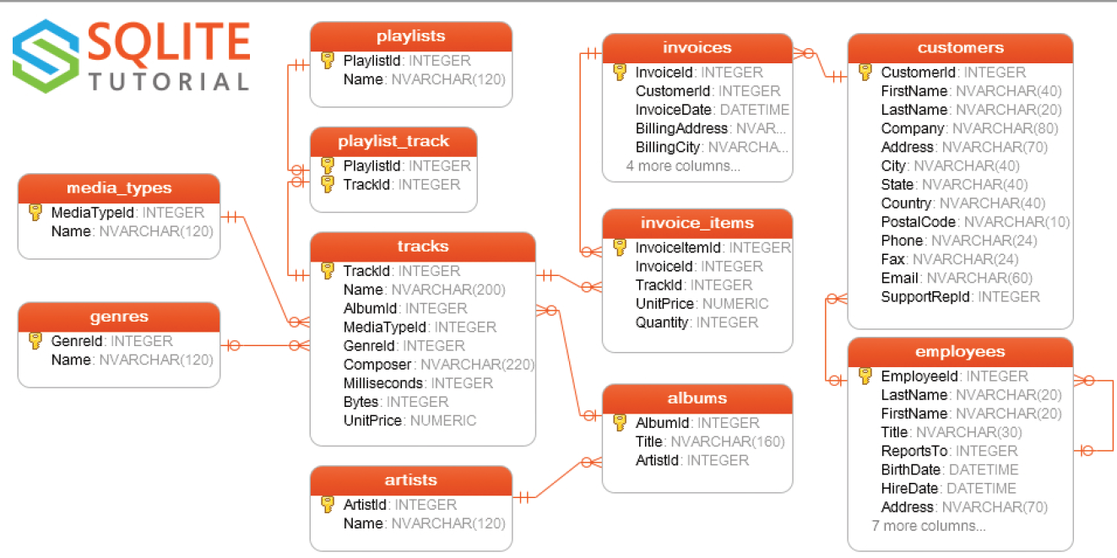

Query Time
Please add a table to your existing chinook database:
The table name will be leaves we will use it ot keep record of the employees’ annual or sick leaves
Column names:
id
employee_id
start_date
end_date
Notes:
Answer:
Postgre
CREATE TABLE leaves
(id INT,
employee_id INT,
start_date DATE,
end_date DATE
)
SQLite3
CREATE TABLE leaves
(id INT,
employee_id INT,
start_date DATE,
end_date DATE
)

Slide 21

Please add a table to your existing sql_course database:
The table name will be vacation_plan of the employees for this summer.
Column names:
place_id
country
hotel_name
employee_id
vacation_length
budget
Notes:
Answer:
SQLite3
CREATE TABLE vacation_plan
(place_id INT,
country TEXT,
hotel_name TEXT,
employee_id INT,
vacation_lenght INT,
budget REAL
);
Bu şekilde de yapabiliriz;
CREATE TABLE vacation_plan
(place_id INT,
country VARCHAR(20),
hotel_name VARCHAR(30),
employee_id INT,
vacation_lenght INT,
budget DECIMAL
);
DROP TABLE IF EXISTS vacation_plan; (Daha önce varsa aynı isimde onu siler)

Slide 22
DROP TABLE
The DROP TABLE statement is used to drop an existing table in a database.
Syntax:
DROP TABLE table_name;
TRUNCATE TABLE table_name;
Notes:
Note: Be careful before dropping a table. Deleting a table will result in loss of complete information stored in the table!
The TRUNCATE TABLE statement is used to delete the data inside a table, but not the table itself.
?
The TRUNCATE TABLE statement is also used to delete the data inside a table (this command does not work on SqLite database), but not the table itself.

Slide 23
ALTER TABLE
4
Notes:
Before moving, let’s insert some data to the revised table named “ new_vacation_plan “
INSERT INTO new_vacation_plan (place_id, country, hotel_name, vacation_lenght, budget, employee_id)
VALUES (1, 'Canada', 'Hilton', 5, 10000, 1),
(2, 'USA', 'Sheraton', 8, 10000, 2),
(3, 'Turkey', 'Izmir', 7, 5000, 3);

Slide 24
ALTER TABLE
The ALTER TABLE statement is used to add, delete, or modify columns in an existing table.
It is also used to add and drop various constraints on an existing table.
To add a column in a table, use the following syntax:
ALTER TABLE table_name
ADD column_name data_type;
Notes:
The ALTER TABLE statement is used to add, delete, or modify columns in an existing table.
The ALTER TABLE statement is also used to add and drop various constraints on an existing table.

Slide 25
Add a column to your vacation_plan table named “city”.
ALTER TABLE table_name
ADD column_name data_type;
Notes:
Answer:
Please drop the table as you’ve just created writing DROP TABLE vacation_plan;
Then recreate the vacation_plan table. This time, add a constrain
ALTER TABLE new_vacation_plan
ADD city TEXT;
Not:
ALTER TABLE "Albumx" RENAME TO "Album";
ALTER TABLE table_name
ADD column_name data_type;

Slide 26
ALTER TABLE
To delete a column in a table, use the following syntax:
ALTER TABLE table_name
DROP column_name;
To change the data type of a column in a table, use the following syntax:
ALTER TABLE table_name
MODIFY COLUMN column_name data_type;
Notes:
The ALTER TABLE statement is used to add, delete, or modify columns in an existing table.
The ALTER TABLE statement is also used to add and drop various constraints on an existing table.
But SQLite does not support MODIFY commands..
change table name;
ALTER TABLE new_vacation_plan
RENAME TO brandnew_vacation_plan;
change column name;
ALTER TABLE brandnew_vacation_plan
RENAME COLUMN city TO state;
ALTER TABLE table_name
ADD column_name data_type;
ALTER TABLE table_name
DROP column_name;
ALTER TABLE table_name
MODIFY COLUMN column_name data_type;

Slide 27
Drop the city column from vacation_plan table.
ALTER TABLE table_name
DROP column_name;
Notes:
ALTER TABLE new_vacation_plan
DROP state;
ALTER TABLE table_name
ADD column_name data_type;
ALTER TABLE table_name
DROP column_name;
ALTER TABLE table_name
MODIFY COLUMN column_name data_type;
ALTER TABLE table_name
DROP column_name;

Slide 28
Constraints
Constraints are the rules specified for data in a table. We can limit the type of data that will go into a table with the constraints. We can define the constraints with the CREATE TABLE statement or ALTER TABLE statement.
Notes:
Constraints can be specified when the table is created with the CREATE TABLE statement, or after the table is created with the ALTER TABLE statement.
SQL constraints are used to specify rules for the data in a table.
Constraints are used to limit the type of data that can go into a table. This ensures the accuracy and reliability of the data in the table. If there is any violation between the constraint and the data action, the action is aborted.

Slide 29
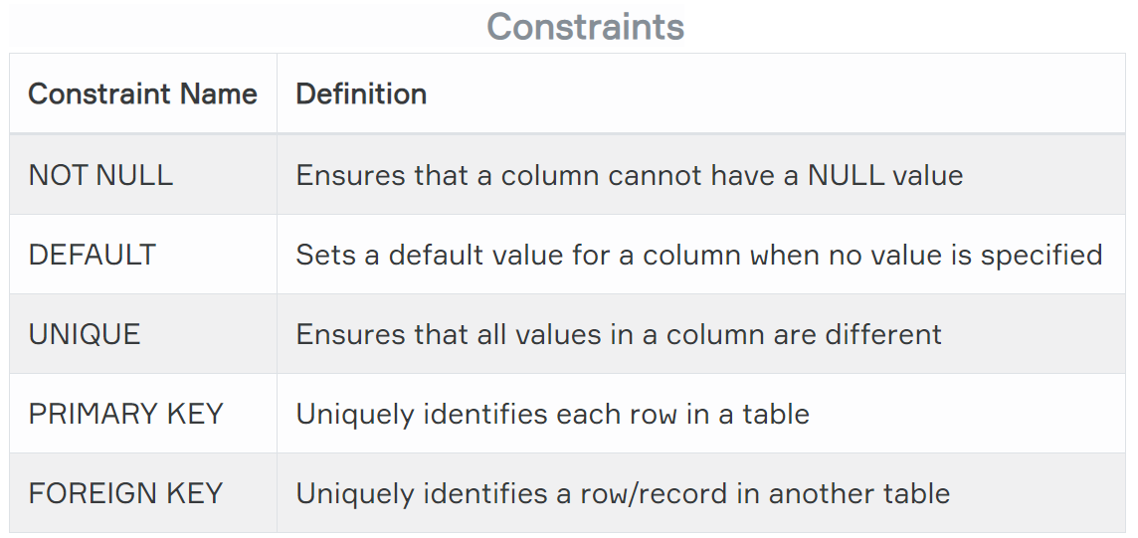
Constraints
Notes:
Constraints can be column level or table level. Column level constraints apply to a column, and table level constraints apply to the whole table.
The following constraints are commonly used in SQL:
NOT NULL - Ensures that a column cannot have a NULL value
UNIQUE - Ensures that all values in a column are different (email, username, cellphone)
PRIMARY KEY - A combination of a NOT NULL and UNIQUE. Uniquely identifies each row in a table
FOREIGN KEY - Uniquely identifies a row/record in another table
CHECK - Ensures that all values in a column satisfies a specific condition
DEFAULT - Sets a default value for a column when no value is specified
INDEX - Used to create and retrieve data from the database very quickly

Slide 30
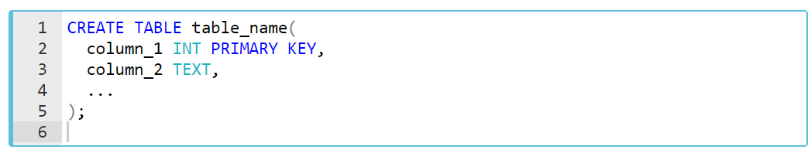
Primary Key
The primary key is a column in our table that makes each row (aka, record) unique.
Syntax
Notes:
The PRIMARY KEY constraint uniquely identifies each record in a table.
Primary keys must contain UNIQUE values, and cannot contain NULL values.
A table can have only ONE primary key; and in the table, this primary key can consist of single or multiple columns (fields).
User ID can be a Primary Key in instagram DB
Or artist_id is a PK in chinook db
EXAMPLE
SELECT *
FROM artists
SELECT *
FROM albums

Slide 31
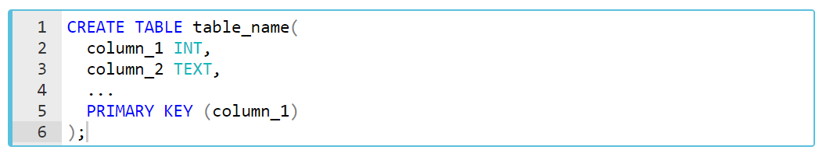
Primary Key
Syntax (Alternative)

Slide 32
Foreign Key
Foreign key is a column in a table that uniquely identifies each row of another table. That column refers to a primary key of another table. This creates a kind of link between the tables.
Notes:
A FOREIGN KEY is a key used to link two tables together.
A FOREIGN KEY is a field (or collection of fields) in one table that refers to the PRIMARY KEY in another table.
The table containing the foreign key is called the child table, and the table containing the candidate key is called the referenced or parent table.
From diagram and database show the albums and artists table:
ArtistId in albums table is a foreign key

Slide 33
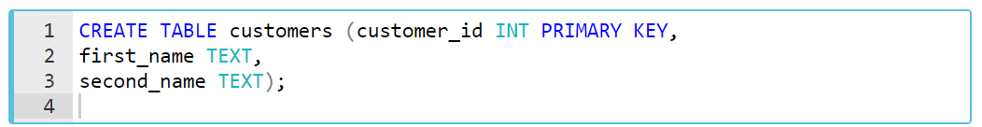
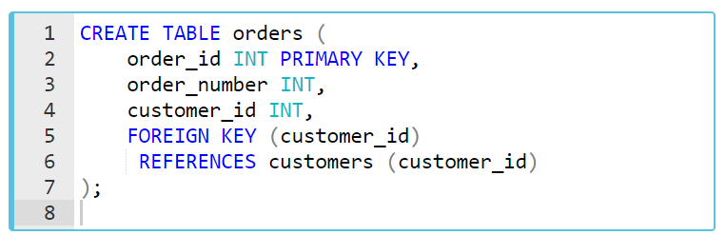
Foreign Key
customers
orders
Notes:
Let's create two tables as customers and orders inside the store database.
Let's create two tables as customers and orders inside the store database.
EXAMPLES;
CREATE TABLE clients
(Client_id INT PRIMARY KEY,
FirstName TEXT NOT NULL,
LastName TEXT);
INSERT INTO clients (Client_id, FirstName, LastName)
VALUES (1, 'John', 'King'),
(2, 'Mehmet', 'Silver'),
(3, 'Sevde', 'Gold');
-- (4, 'Sevda', 'Gold2');
CREATE TABLE orders
(Order_id INT PRIMARY KEY,
Order_Nu INTEGER,
Client_id INTEGER,
FOREIGN KEY (Client_id)
REFERENCES clients (Client_id)
);
INSERT INTO orders (Order_id, Order_Nu , Client_id )
VALUES (1, 101, 1),
(2, 102, 2),
(3, 103, 3);
--(4, 104, 4);

Slide 34
Query Time
Try to insert a record in albums table with an ArtistID=10000 and AlbumID=347
Notes:
Postgre
INSERT INTO "Album" ("AlbumId","Title","ArtistId")
VALUES (349,'My new album',100);
SQLite
INSERT INTO albums
(AlbumID,Title,ArtistID)
VALUES
(347,'My new album',1000)
You will get a UNIQUE constraint error because of 347 is already in database
Try this one and you will get a FOREIGN KEY error because there is no ArtistID 1000
INSERT INTO albums
(AlbumID,Title,ArtistID)
VALUES
(348,'My new album',1000)
This one works:
INSERT INTO albums
(AlbumID,Title,ArtistID)
VALUES
(348,'My new album',100)
And this one to show autoincrement
INSERT INTO albums
(AlbumID,Title,ArtistID)
VALUES
(348,'My new album',1000)
THEN TRY THIS ONE
INSERT INTO leaves
(id, employee_id,start_date, end_date)
VALUES
(1,22,'2021-02-01','2021-02-15')
We have 2 problems here:
both records have same id of 1
we put employee id 22 but there is no employee with an id 22
SELECT * FROM leaves a
left join employees e on e.EmployeeId=a.employee_id
We will use constraints to fix these problems

Slide 35
Not Null
A column can include NULL values. A NULL value is a special value that means the value is unknown or does not exist.
All columns (except primary key's column) in a table can hold NULL values unless we explicitly specify NOT NULL constraints.
Notes:
By default, a column can hold NULL values.
The NOT NULL constraint enforces a column to NOT accept NULL values.
This enforces a field to always contain a value, which means that you cannot insert a new record, or update a record without adding a value to this field.

Slide 36
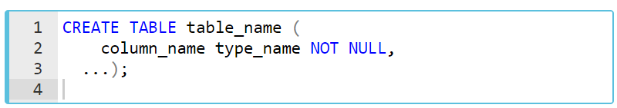
Not Null
Syntax

Slide 37
Data Manipulation Language
INSERT
UPDATE
DELETE
SELECT
Notes:
The SQL commands that deals with the manipulation of data present in the database belong to DML or Data Manipulation Language and this includes most of the SQL statements.
INSERT – is used to insert data into a table.
UPDATE – is used to update existing data within a table.
DELETE – is used to delete records from a database table.

Slide 38
INSERT INTO
Syntax:
INSERT INTO table_name (column1, column2 ,..)
VALUES( value1, value2 ,...);
INSERT INTO table1 (column1,column2 ,..)
VALUES
(value1,value2 ,...),
(value1,value2 ,...),
...
(value1,value2 ,...);
Notes:
The SQL INSERT INTO Statement
The INSERT INTO statement is used to insert new records in a table.
It is possible to write the INSERT INTO statement in two ways.
The first way specifies both the column names and the values to be inserted:
If you are adding values for all the columns of the table, you do not need to specify the column names in the SQL query. However, make sure the order of the values is in the same order as the columns in the table.
Insert Data Only in Specified Columns
It is also possible to only insert data in specific columns.
EXAMPLE
CREATE TABLE students
(Student_id INT PRIMARY KEY,
FirstName TEXT,
LastName TEXT,
Grade INT);
INSERT INTO students (Student_id, FirstName, LastName, Grade)
VALUES (1, 'julia', 'Saelens', 99),
(2, 'Hanan', 'Qattan', 89),
(3, 'Anu', 'Rowe', 87),
(4, 'Nicholas', 'Perros', 94),
(5, 'Alexandra', 'Barraclough', 90),
(6, 'Luis', 'Vasquez', 96);
CREATE TABLE grades
(Grade INT PRIMARY KEY,
Student_id INT,
FOREIGN KEY (Student_id)
REFERENCES students (Student_id)
);
DROP TABLE students
DROP TABLE grades
************************************

Slide 39
Query Time
INSERT a record for an employee into leaves table
id INT,
employee_id INT,
start_date DATE,
end_date DATE
Notes:
INSERT INTO leaves
(id, employee_id,start_date, end_date)
VALUES
(1,2,'2021-02-01','2021-02-15')
THEN TRY THIS ONE
INSERT INTO leaves
(id, employee_id,start_date, end_date)
VALUES
(1,22,'2021-02-01','2021-02-15')
We have 2 problems here:
both records have same id of 1
we put employee id 22 but there is no employee with an id 22
SELECT * FROM leaves a
left join employees e on e.EmployeeId=a.employee_id
We will use constraints to fix these problems

Slide 40
Query Time
Try to insert a record in albums table without a title value
Notes:
INSERT INTO albums
(ArtistID)
VALUES
(100)
NOT NULL constraint failed: albums.Title
This one workes because ‘’ is different than NULL
INSERT INTO albums
(Title,ArtistID)
VALUES
('',100)

Slide 41
Please drop the table as you’ve just created writing
DROP TABLE vacation_plan;
Then, recreate the vacation_plan table adding constraints as below:
Column names:
place_id -> PRIMARY KEY
country
hotel_name -> NOT NULL
employee_id -> FOREIGN KEY
vacation_length
budget
Notes:
CREATE TABLE vacation_plan
(place_id INT,
country TEXT,
hotel_name TEXT,
employee_id INT,
vacation_lenght INT,
budget REAL
);
DROP TABLE vacation_plan;
CREATE TABLE new_vacation_plan
(place_id INT PRIMARY KEY,
country TEXT,
hotel_name TEXT NOT NULL,
vacation_lenght INT,
budget REAL,
employee_id INT,
FOREIGN KEY (employee_id)
REFERENCES employees (EmployeeId)
);

Slide 42
Query Time
Please drop the table as you’ve just created writing
DROP TABLE leaves;
Then, recreate the leaves table adding constraints as below:
Column names:
id -> PRIMARY KEY , AUTOINC
employee_id -> FOREING KEY
start_date -> NOT NULL
end_date -> NOT NULL
Notes:
First drop and recreate the leaves table again
CREATE TABLE "leaves" (
id INTEGER NOT NULL,
employee_id INT,
start_date DATE NOT NULL,
end_date DATE NOT NULL,
PRIMARY KEY("id" AUTOINCREMENT),
FOREIGN KEY("employee_id") REFERENCES "employees"("EmployeeId")
);
NOW TRY TO INSERT THE SAME VALUES
INSERT INTO leaves
(id, employee_id,start_date, end_date)
VALUES
(1,22,'2021-02-01','2021-02-15')
INSERT INTO leaves
(id, employee_id,start_date, end_date)
VALUES
(1,22,'2021-02-01','2021-02-15')
employe_id=22
id=1 (duplicate value)

Slide 43
Query Time
Alter the table name to employee_leaves first. (Google this one know if you don’t know)
Then add a column to your leaves table named “leave_type”.
We will use type of leaves such as “annual leave”, “sick leave” and etc.
Notes:
ALTER TABLE annual_leaves
RENAME TO employee_leaves;
ALTER TABLE leaves
ADD leave_type char(30)
INSERT INTO employee_leaves
(id, employee_id,start_date, end_date)
VALUES
(2,3,'2021-02-01','2021-02-15')
as you see the new column that we add is NULL, let’s put a constraint to it so that it doesn’t let NULL values
Do this time from menu

Slide 44
Query Time
INSERT 3 new records to employee_leaves table.
You can use “annual_leave”, sick_leave” and etc for leave type
Notes:
INSERT INTO employee_leaves
(employee_id,start_date, end_date,leave_type)
VALUES
(4,'2021-02-01','2021-02-15','annual')
typo in annual
So it’s not a good idea to have string data type for column leave_type
End users can put different info in it and it can be hard to analyze later

Slide 45
Query Time
Now add another table leave_types with
id -> PK AUTOINC
leave_name ->TEXT
And make the column in employee_leaves table as FOREIGN KEY
ADD 3 records to leave_types and employee_leaves table
Notes:
CREATE TABLE leave_types (
id INTEGER NOT NULL,
leave_name TEXT,
PRIMARY KEY("id" AUTOINCREMENT)
);
CREATE TABLE "employee_leaves" (
id INTEGER NOT NULL,
employee_id INT,
start_date DATE NOT NULL,
end_date DATE NOT NULL,
leave_type int NOT NULL,
PRIMARY KEY("id" AUTOINCREMENT),
FOREIGN KEY("employee_id") REFERENCES "employees"("EmployeeId"),
FOREIGN KEY("leave_type") REFERENCES "leave_typeS"("id")
);
INSERT INTO leave_types
(id,leave_name)
VALUES
(1,’Annual Leave’)
INSERT INTO leave_types
(id,leave_name)
VALUES
(1,'Annual Leave')
INSERT INTO leave_types
(leave_name)
VALUES
('Sick Leave')
INSERT INTO employee_leaves
(employee_id,start_date, end_date,leave_type)
VALUES
(4,'2021-02-01','2021-02-15',1)

Slide 46
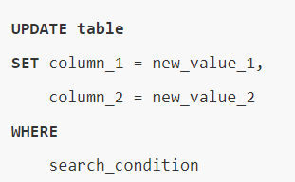
UPDATE TABLE
Notes:
In this syntax:
First, specify the table where you want to update after the UPDATE clause.
Second, set new value for each column of the table in the SET clause.
Third, specify rows to update using a condition in the WHERE clause. The WHERE clause is optional. If you skip it, the UPDATE statement will update data in all rows of the table.

Slide 47
Query Time
Change the name of Annual leave to Marriage Leave in leave_types table
Change the start and end date values of a record in employee_leaves table
google sqlite date add
Notes:
UPDATE leave_types
SET leave_name='Marriage Leave'
WHERE id=1
UPDATE leave_types
SET leave_name='Marriage Leave'
WHERE leave_name='Sick Leave'
UPDATE employee_leaves
SET start_date='2021-02-10',
end_date='2021-02-25'
WHERE id=1
Find me a better way
google sqlite date add
https://www.sqlitetutorial.net/sqlite-date-functions/sqlite-date-function/
UPDATE employee_leaves
SET start_date=DATE(start_date,'+10 days'),
end_date=DATE(end_date,'+10 days')
WHERE id=1

Slide 48

DELETE
Notes:
In this syntax:
First, specify the name of the table which you want to remove rows after the DELETE FROM keywords.
Second, add a search condition in the WHERE clause to identify the rows to remove. The WHERE clause is an optional part of the DELETE statement. If you omit the WHERE clause, the DELETE statement will delete all rows in the table.

Slide 49
Query Time
Delete a record from leave types table
Delete a record from employee leaves table
Notes:
DELETE FROM leave_types
where id = 1
DELETE FROM employee_leaves
where id = 1
!! FK constraint doesn’t let you remove the record that is connected to another table, which is something good

Slide 50
Data Control Language
Data Control Language (DCL) is used to grant or revoke access control.
GRANT
GRANT DELETE ON table_name TO user
REVOKE
REVOKE DELETE ON table_name FROM user
Notes:
DCL includes commands such as GRANT and REVOKE which mainly deals with the rights, permissions and other controls of the database system.
Examples of DCL commands:
GRANT-gives user’s access privileges to database.
REVOKE-withdraw user’s access privileges given by using the GRANT command.
GRANT
Sistem ya da nesne haklarının kullanıcılara veya rollere atanması için kullanılan komuttur.
GRANT DELETE ON personel TO ogrenci
Yukarıdaki örnekte ogrenci kullanıcısına personel tablosunda silme yapma yetkisi verilir.
REVOKE
Sistem ya da nesne haklarının kullanıcılardan veya rollerden geri alınnması için kullanılan komuttur.
REVOKE DELETE ON personel FROM ogrenci
Yukarıdaki örnekte ogrenci kullanıcısından personel tablosunda silme yapma yetkisi geri alınır

Slide 51
Data Control Language
GRANT SELECT,INSERT,UPDATE,DELETE ON *.* TO ‘user_name’@’localhost’;
GRANT ALL ON *.* TO ‘user_name’@’localhost’;
DROP USER user_name;
Notes:
GRANT SELECT,INSERT,UPDATE,DELETE ON *.* TO "deneme’@’localhost’;
Bu komut satırıyla deneme user’ımıza select,insert,update ve delete yetkisi vermiş olduk.
GRANT ALL ON *.* TO "deneme’@’localhost’;
Bu komut satırıyla da deneme user’ımıza full yetki vermiş oluruz.
deneme user’ını silmek için de; DROP USER deneme;
Komut satırını Çalıştırdığımızda da deneme userını silmiş olacağız.

Slide 52
Index
CREATE INDEX
CREATE INDEX indeks1 ON emp(id)
CREATE INDEX emp_idx1 ON emp (ename, job);
CREATE INDEX emp_idx2 ON emp (job, ename);
Notes:
indeks tablodaki kayıtlara daha hızlı erişim için kullanılan nesnelerdir.
Bir indeks oluşturabilmek için “CREATE ANY INDEX” sistem hakkına sahip olmak gerekir. İndeks bir tablonun bir alanı üzerinde tanımlanabileceği gibi birden fazla alan üzerinde de tanımlanabilir.
İndeksler verilere hızlı erişim amacıyla kullanılır.
OLAP (On-Line Analytical Processing) sistemlerde mümkün olduğu kadar çok indeks kullanılır, OLTP’de ise fazlası uygulamaya zarar verebilir.
Primary Key’ler otomatik olarak indekslenir, Foreign Key’ler de genellikle indekslenmesi gereken alanlardır.
WHERE koşulu ile seçilen sütunlar, aynı sırada indeks yapılmalıdır.

Slide 53
View
CREATE VIEW emp_view AS
SELECT empno, ename, sal, loc
FROM emp, dept
WHERE emp.deptno = dept.deptno
AND dept.deptno = 10;
CREATE VIEW dept20 AS
SELECT ename, sal*12 annual_salary
FROM emp
WHERE deptno = 20;
Notes:
Gerçekte olmayan tablolardır. Sadece SELECT ifadesinden ibarettirler.
Neden view kullanılır?
Veri erişimini sınırlamak için
Karmaşık sorguları kolay hale getirmek için
Veri bağımsızlığını sağlamak için
Aynı verinin farklı görünümlerini sunmak için
Eğer Primary Key View’da yer alıyorsa DML (insert, delete, update) işlemleri o view üzerinde uygulanabilir.

Slide 54
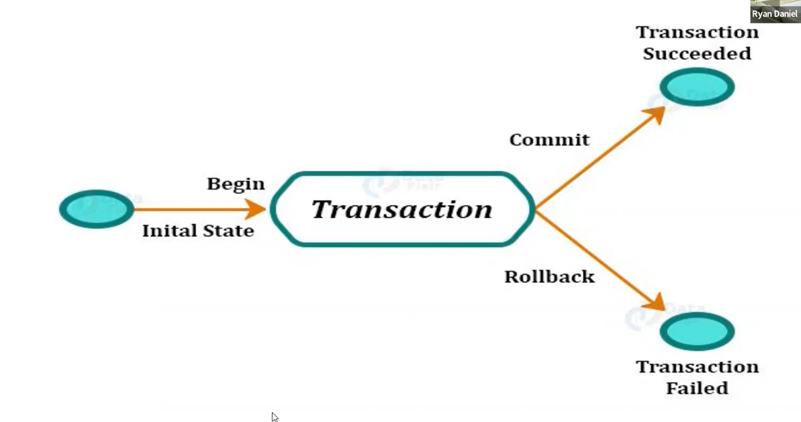
Transaction
Notes:
Daha küçük parçalara ayrılamayan en küçük işlem yığınına Transaction denir.
Geçerli kabul edilmesi bir dizi işlemin tamamının yolunda gitmesine bağlı durumlarda transaction kullanılır.
Transaction bloğu ya hep ya hiç mantığı ile çalışır. Ya tüm işlemler düzgün olarak gerçekleşir ve geçerli kabul edilir veya bir kısım işlemler yolunda gitse bile, blok sona ermeden bir işlem bile yolunda gitmese hiçbir işlem olmamış kabul edilir.
Bir transaction COMMIT işlemi ile tamamlanır. Eğer ROLLBACK işlemi uygulanırsa tüm transaction işlemleri geri alınır.
Örneğin; bir havale işleminde, havale yapanın hesap bilgilerinden havale yaptığı miktar düşüldükten sonra, elektrik kesintisi, donanımsal veya yazılımsal bir arıza nedeniyle alıcının hesabına bu miktar eklenemez ise; gönderenin hesabından düşülen paranın iade edilmesi gerekir.
Aksi halde bu paranın sahibinin kimliği kaybedilmiş olur. Bu da sistemin olası haller dışında veri kaybetmeye müsait bir durumda olması demektir. Bu tür aksaklıklar transaction kavramı sayesinde kontrol altına alınır.
mysql_connect("localhost", "kullanici", "parola");
mysql_select_db("veritabani");
//transaction basliyor mysql_query("BEGIN");
//sorgular hazirlaniyor
$sorgu1 = mysql_query("UPDATE akbank SET mevcut_para = mevcut_para – 10000 WHERE hesap_no = '625021'");
$sorgu2 = mysql_query("UPDATE garanti SET mevcut_para = mevcut_para + 10000 WHERE hesap_no = '124500'"); ,
if (!$sorgu1 or !$sorgu2 ) {
//hata var, geri aliyoruz mysql_query("ROLLBACK");
}
else {
//hata yok, islem tamamlaniyor mysql_query("COMMIT");
}

Slide 55
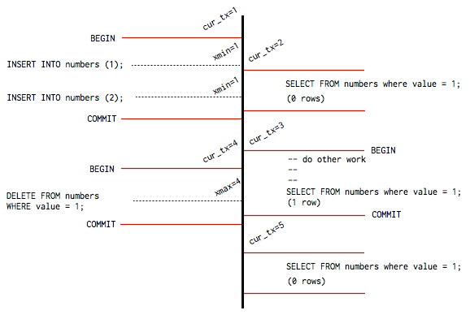
Transaction
Notes:
Daha küçük parçalara ayrılamayan en küçük işlem yığınına Transaction denir.
Geçerli kabul edilmesi bir dizi işlemin tamamının yolunda gitmesine bağlı durumlarda transaction kullanılır.
Transaction bloğu ya hep ya hiç mantığı ile çalışır. Ya tüm işlemler düzgün olarak gerçekleşir ve geçerli kabul edilir veya bir kısım işlemler yolunda gitse bile, blok sona ermeden bir işlem bile yolunda gitmese hiçbir işlem olmamış kabul edilir.
Bir transaction COMMIT işlemi ile tamamlanır. Eğer ROLLBACK işlemi uygulanırsa tüm transaction işlemleri geri alınır.
Örneğin; bir havale işleminde, havale yapanın hesap bilgilerinden havale yaptığı miktar düşüldükten sonra, elektrik kesintisi, donanımsal veya yazılımsal bir arıza nedeniyle alıcının hesabına bu miktar eklenemez ise; gönderenin hesabından düşülen paranın iade edilmesi gerekir.
Aksi halde bu paranın sahibinin kimliği kaybedilmiş olur. Bu da sistemin olası haller dışında veri kaybetmeye müsait bir durumda olması demektir. Bu tür aksaklıklar transaction kavramı sayesinde kontrol altına alınır.
mysql_connect("localhost", "kullanici", "parola");
mysql_select_db("veritabani");
//transaction basliyor mysql_query("BEGIN");
//sorgular hazirlaniyor
$sorgu1 = mysql_query("UPDATE akbank SET mevcut_para = mevcut_para – 10000 WHERE hesap_no = '625021'");
$sorgu2 = mysql_query("UPDATE garanti SET mevcut_para = mevcut_para + 10000 WHERE hesap_no = '124500'"); ,
if (!$sorgu1 or !$sorgu2 ) {
//hata var, geri aliyoruz mysql_query("ROLLBACK");
}
else {
//hata yok, islem tamamlaniyor mysql_query("COMMIT");
}

Slide 56
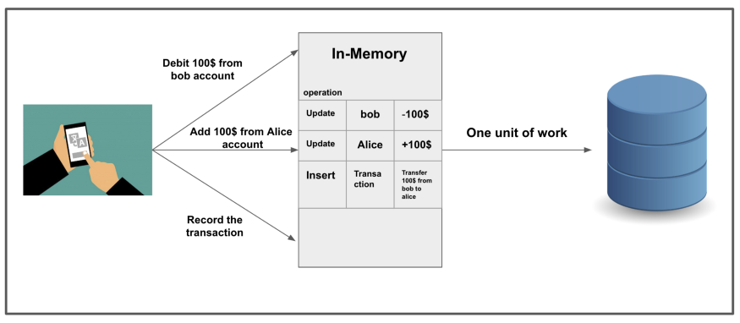
Transaction
Notes:
Daha küçük parçalara ayrılamayan en küçük işlem yığınına Transaction denir.
Geçerli kabul edilmesi bir dizi işlemin tamamının yolunda gitmesine bağlı durumlarda transaction kullanılır.
Transaction bloğu ya hep ya hiç mantığı ile çalışır. Ya tüm işlemler düzgün olarak gerçekleşir ve geçerli kabul edilir veya bir kısım işlemler yolunda gitse bile, blok sona ermeden bir işlem bile yolunda gitmese hiçbir işlem olmamış kabul edilir.
Bir transaction COMMIT işlemi ile tamamlanır. Eğer ROLLBACK işlemi uygulanırsa tüm transaction işlemleri geri alınır.
Örneğin; bir havale işleminde, havale yapanın hesap bilgilerinden havale yaptığı miktar düşüldükten sonra, elektrik kesintisi, donanımsal veya yazılımsal bir arıza nedeniyle alıcının hesabına bu miktar eklenemez ise; gönderenin hesabından düşülen paranın iade edilmesi gerekir.
Aksi halde bu paranın sahibinin kimliği kaybedilmiş olur. Bu da sistemin olası haller dışında veri kaybetmeye müsait bir durumda olması demektir. Bu tür aksaklıklar transaction kavramı sayesinde kontrol altına alınır.
mysql_connect("localhost", "kullanici", "parola");
mysql_select_db("veritabani");
//transaction basliyor mysql_query("BEGIN");
//sorgular hazirlaniyor
$sorgu1 = mysql_query("UPDATE akbank SET mevcut_para = mevcut_para – 10000 WHERE hesap_no = '625021'");
$sorgu2 = mysql_query("UPDATE garanti SET mevcut_para = mevcut_para + 10000 WHERE hesap_no = '124500'"); ,
if (!$sorgu1 or !$sorgu2 ) {
//hata var, geri aliyoruz mysql_query("ROLLBACK");
}
else {
//hata yok, islem tamamlaniyor mysql_query("COMMIT");
}

Slide 57
Transaction
mysql_connect("localhost", "username", "password");
mysql_select_db("db_name");
//transaction begining
mysql_query("BEGIN");
//query preparing
$query1 = mysql_query("UPDATE akbank SET acoount= acoount – 10000 WHERE account_no = '625021'");
$query2 = mysql_query("UPDATE garanti SET acoount = acoount + 10000 WHERE account_no = '124500'"); ,
if (!$query1 or !$query2 ) {
("ROLLBACK");
}
else {
("COMMIT");
}
Notes:
Daha küçük parçalara ayrılamayan en küçük işlem yığınına Transaction denir.
Geçerli kabul edilmesi bir dizi işlemin tamamının yolunda gitmesine bağlı durumlarda transaction kullanılır.
Transaction bloğu ya hep ya hiç mantığı ile çalışır. Ya tüm işlemler düzgün olarak gerçekleşir ve geçerli kabul edilir veya bir kısım işlemler yolunda gitse bile, blok sona ermeden bir işlem bile yolunda gitmese hiçbir işlem olmamış kabul edilir.
Bir transaction COMMIT işlemi ile tamamlanır. Eğer ROLLBACK işlemi uygulanırsa tüm transaction işlemleri geri alınır.
Örneğin; bir havale işleminde, havale yapanın hesap bilgilerinden havale yaptığı miktar düşüldükten sonra, elektrik kesintisi, donanımsal veya yazılımsal bir arıza nedeniyle alıcının hesabına bu miktar eklenemez ise; gönderenin hesabından düşülen paranın iade edilmesi gerekir.
Aksi halde bu paranın sahibinin kimliği kaybedilmiş olur. Bu da sistemin olası haller dışında veri kaybetmeye müsait bir durumda olması demektir. Bu tür aksaklıklar transaction kavramı sayesinde kontrol altına alınır.
mysql_connect("localhost", "kullanici", "parola");
mysql_select_db("veritabani");
//transaction basliyor mysql_query("BEGIN");
//sorgular hazirlaniyor
$sorgu1 = mysql_query("UPDATE akbank SET mevcut_para = mevcut_para – 10000 WHERE hesap_no = '625021'");
$sorgu2 = mysql_query("UPDATE garanti SET mevcut_para = mevcut_para + 10000 WHERE hesap_no = '124500'"); ,
if (!$sorgu1 or !$sorgu2 ) {
//hata var, geri aliyoruz mysql_query("ROLLBACK");
}
else {
//hata yok, islem tamamlaniyor mysql_query("COMMIT");
}

Slide 58
Trigger
CREATE [or REPLACE] TriggerName
[ BEFORE | AFTER ]
[ DELETE | INSERT | UPDATE [of ColumnName ] ]
ON [User.]TableName
[ FOR EACH ROW ] [ WHEN Condition ]
BEGIN
[PL/SQL Block]
END ;
Notes:
BEFORE / AFTER: DML ifadesinden önce / sonra tetikle
FOR EACH ROW: Etkilenen her satır için tekrar tetikle
WHEN: Tetikleyiciye koşul ekler
Trigger: Kelime anlamı tetikleyici demektir. Tablolar üzerinde gerÇeklerşen bir işlemin başka bir işlemi tetiklemesini sağlayan sql ifadeleri topluluğuna trigger denir
Bir veri tabanında belirli bir tablodaki bir satırın değişmesi gibi belirli bir işlem gerçekleştiğinde otomatik olarak bir işlemi başlatan bir dizi SQL ifadesidir.
Bir trigger bir olaydan (insert, delete ya da update ifadelerin belirtilen tabloda oluşması) ve bir hareketten (ilgili prosedür) oluşur.
Mesela basit olarak şirket tablosuna yeni bir kayıt eklendiğinde (insert) git log tablosuna şirket no’sunu ve o anki tarih ve zamanı kaydet (insert).
trigger_time:Trigger’ın Çalışma zamanıdır. Yani After(sonra,işlemden sonra Çalış) veya Before(önce,işlemden önce Çalış).
trigger_event:Trigger’ın hangi olayda Çalışcağını yazıyoruz. Bu olaylar: INSERT,UPDATE veya DELETE olayları olabilir.
trigger_stmt: BEGIN ……. END blogları arasında tanımladığımız olay ve zamanda yapılmasını istediğimiz işleri yazıyoruz.

Slide 59
THANKS!

